Slide 1
3D Reconstruction with X-Ray Images
Presenter: 方郁婷
E-mail: s830s200s@gmail.com
Phone: 0933826120
Notes:
3D 錫球影像的校正

Slide 2
Outline
Purpose
Reconstruction
ART (Algebraic Reconstruction Technique)
Additive
Multiplicative
Compare
How To Improve?
Notes:
先介紹一下目的
再介紹一下重建有哪些方法
最後介紹重建的其中一個方法(ART)

Slide 3
PURPOSE
Implement the 3-dimensional reconstruction with X-ray images.
Why?
There are several kinds of defects in PCB.
Many defects cannot be seen by human eyes.
Method for inspecting PCB
Automated Optic Inspection (AOI)
Solder Paste Inspection (SPI)
Automated X-ray Inspection (AXI)
Algebraic Reconstruction Technique (ART)
Simultaneous Algebraic Reconstruction Technique (SART)
Filtered Back Projection (FBP)
PCB: Printed Circuit Board

Slide 4
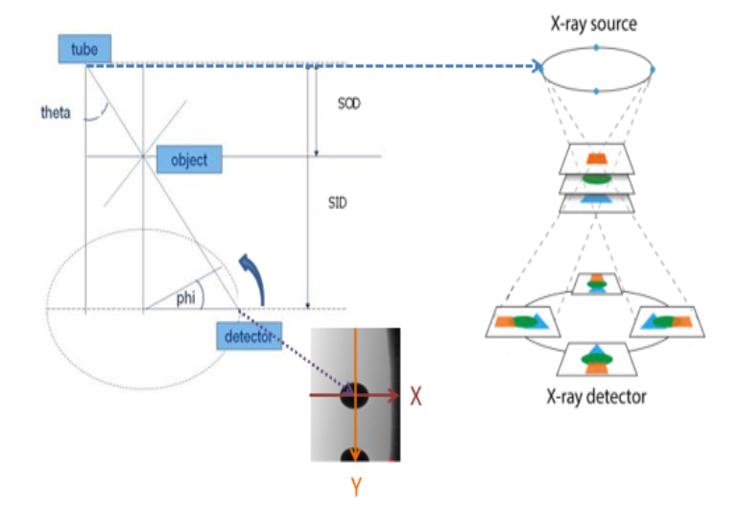
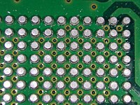
RECONSTRUCTION
SOD: Source to Object Distance
SID: Source to Image Distance
Reconstruction of 3D solder ball
Notes:
Solder: 焊接
PCB（Printed circuit board）
3D: 3 Dimensions
phi : angle of rotation
Theta : the angle between tube to detector and vertical line.

Slide 5
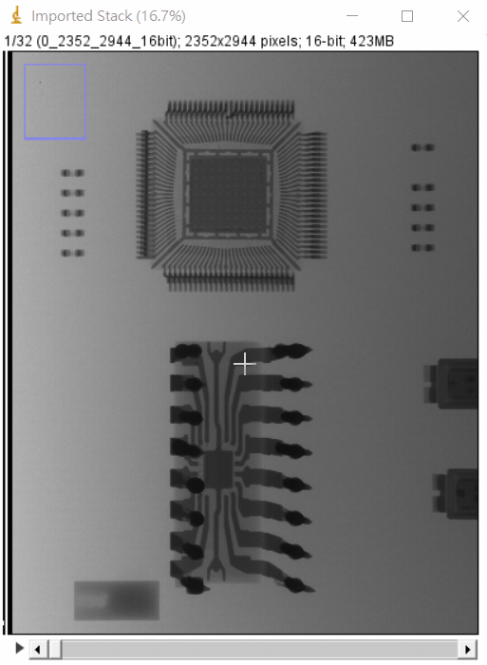
RECONSTRUCTION
32 Projections
Notes:
11.25度

Slide 6
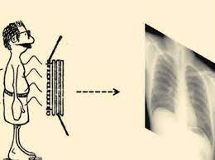
X-ray
X-ray is 3D to 2D
We want to convert these 2D images into 3D images
How? => ART
ART (Algebraic Reconstruction Technique)

Slide 7
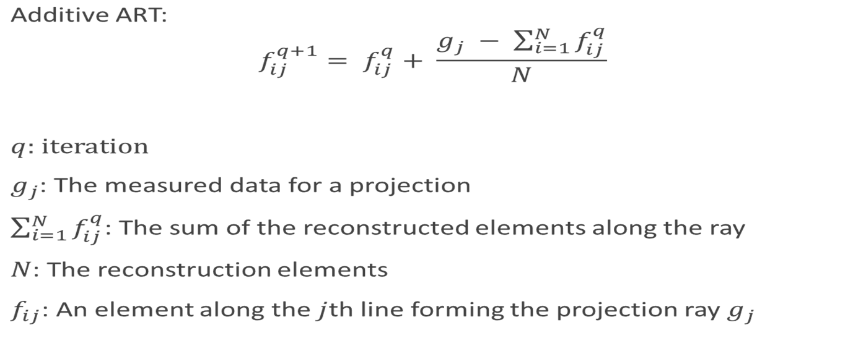
ART (Algebraic Reconstruction Technique)
A classic iterative reconstruction method.
Additive:

Slide 8

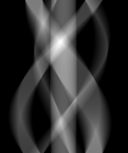
Additive ART
ART: Algebraic Reconstruction Technique
Example: convert 1D to 2D
0°
X-ray
ART
179°
Original image
Sinogram
Notes:
簡化問題=>以1D轉2D為例

Slide 9


Additive ART GIF
ART: Algebraic Reconstruction Technique
GIF: Graphics Interchange Format
0°
179°
Original image
Sinogram

Slide 10
Why only 179 degree
ART: Algebraic Reconstruction Technique
Original image
A picture turned 180 degrees
Notes:
這兩張圖算出來的值是一樣的(只是方向相反而已)

Slide 11
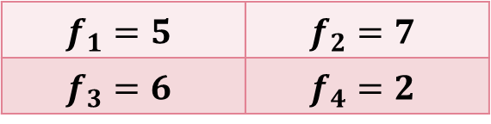
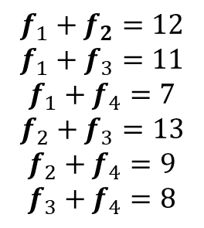
Additive ART
ART: Algebraic Reconstruction Technique
11
9
7
13
$$f_{1}+f_{2}=12$$
$$f_{1}+f_{3}=11$$
$$f_{1}+f_{4}=7$$
$$f_{2}+f_{3}=13$$
$$f_{2}+f_{4}=9$$
$$f_{3}+f_{4}=8$$
12
$$f_{1}=5$$ | $$f_{2}=7$$
$$f_{3}=6$$ | $$f_{4}=2$$
8
Add all directions
Just like the above picture rotation
and column addition
Notes:
Orignal
垂直、對角、水平

Slide 12
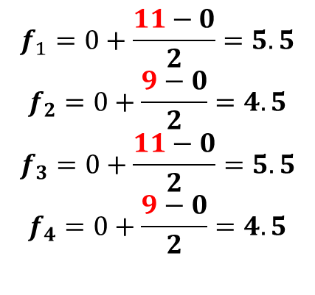
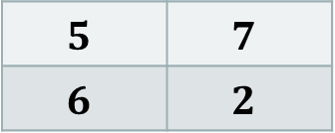
Additive ART
ART: Algebraic Reconstruction Technique
Vertical
$$5$$ | $$7$$
$$6$$ | $$2$$
11
9
0
$$f_{1}=0+\frac{11−0}{2}=5.5$$
$$f_{2}=0+\frac{9−0}{2}=4.5$$
$$f_{3}=0+\frac{11−0}{2}=5.5$$
$$f_{4}=0+\frac{9−0}{2}=4.5$$
0
0 | 0
0 | 0
Notes:
初始0

Slide 13
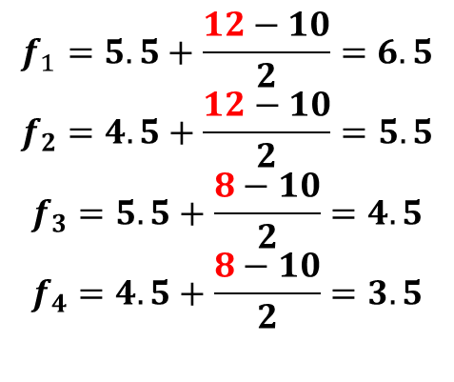
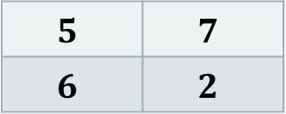
Additive ART
ART: Algebraic Reconstruction Technique
Horizontal
$$5$$ | $$7$$
$$6$$ | $$2$$
$$f_{1}=5.5+\frac{12−10}{2}=6.5$$
$$f_{2}=4.5+\frac{12−10}{2}=5.5$$
$$f_{3}=5.5+\frac{8−10}{2}=4.5$$
$$f_{4}=4.5+\frac{8−10}{2}=3.5$$
5.5 | 4.5
5.5 | 4.5
10
12
10
8
Notes:
初始0

Slide 14
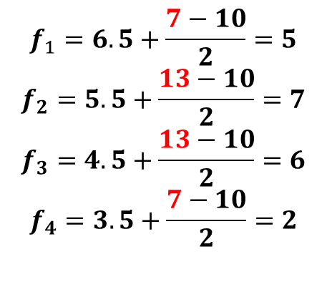
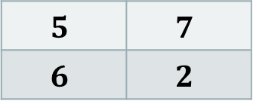
Additive ART
ART: Algebraic Reconstruction Technique
Diagonal
$$5$$ | $$7$$
$$6$$ | $$2$$
7
13
10
10
$$f_{1}=6.5+\frac{7−10}{2}=5$$
$$f_{2}=5.5+\frac{13−10}{2}=7$$
$$f_{3}=4.5+\frac{13−10}{2}=6$$
$$f_{4}=3.5+\frac{7−10}{2}=2$$
6.5 | 5.5
4.5 | 3.5
Notes:
初始0

Slide 15
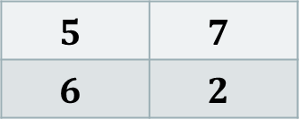
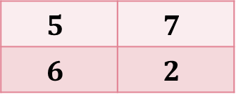
Additive ART
ART: Algebraic Reconstruction Technique
Final
$$5$$ | $$7$$
$$6$$ | $$2$$
$$5$$ | $$7$$
$$6$$ | $$2$$
Notes:
初始0

Slide 16
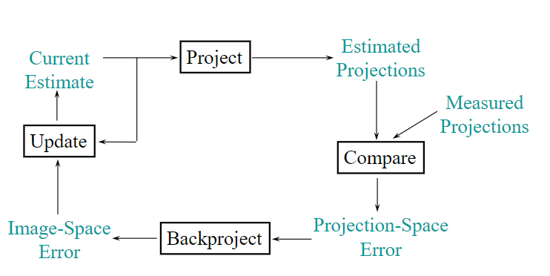
Iterative Reconstruction
Notes:
Measured projections: 實測投影
Estimated projections: 估測影像
projection-space error 投影空間誤差
image-space error:影像空間誤差

Slide 17
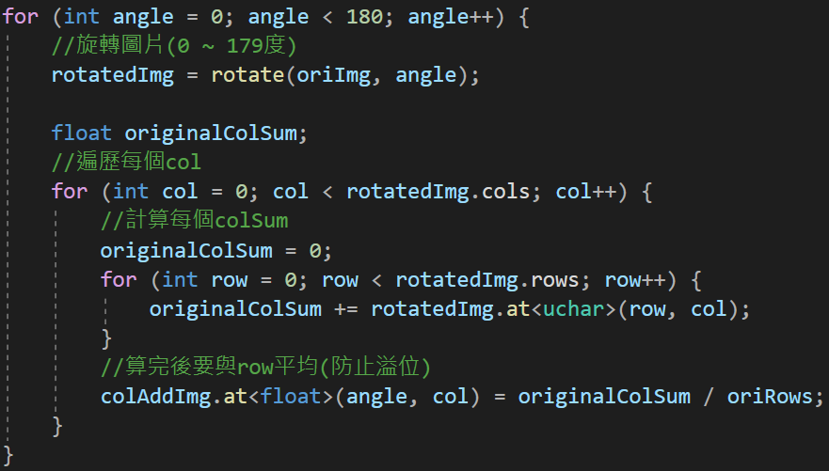
CODE
oriImg
colAddImg

Slide 18
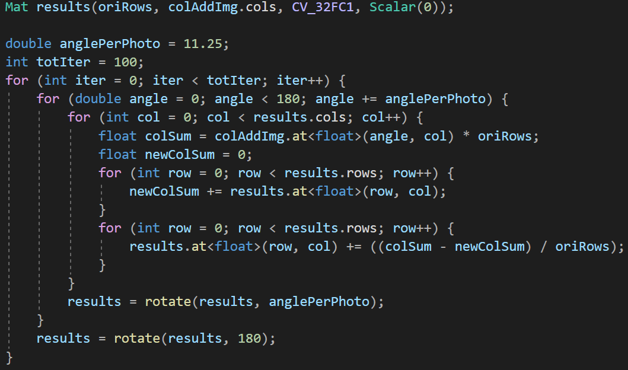
CODE
colAddImg
results

Slide 19
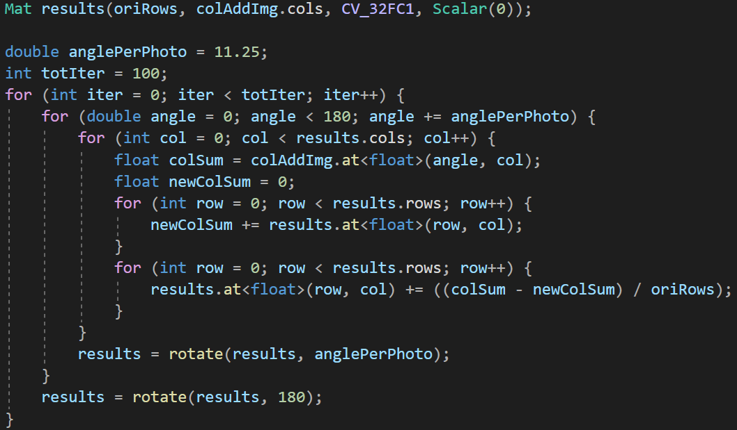
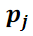
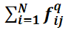
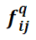
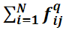
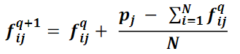
CODE

Slide 20
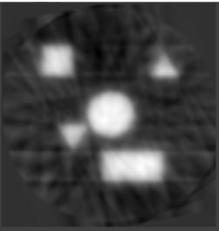
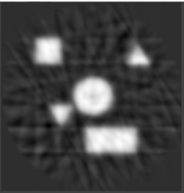

Additive ART
ART: Algebraic Reconstruction Technique
16 Projections
1 Iteration
100 Iterations
500 Iterations
Notes:
跟 180 比，32比較模糊，因為較少的資訊量

Slide 21
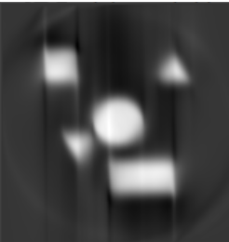
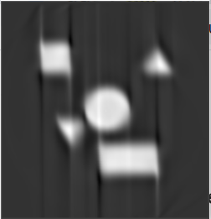
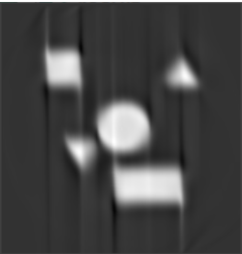
Additive ART
ART: Algebraic Reconstruction Technique
180 Projections
1 Iteration
100 Iterations
500 Iterations

Slide 22


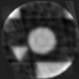
Clip
Graphs that are out of range will be clipped

Slide 23
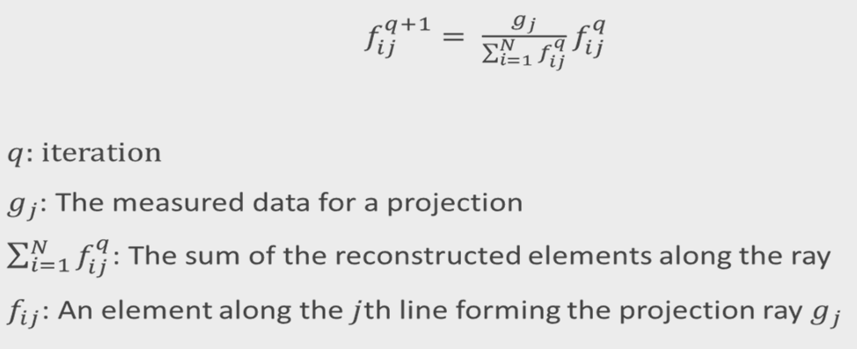
Multiplicative ART
ART: Algebraic Reconstruction Technique
Notes:
Multiplicative: 乘法

Slide 24
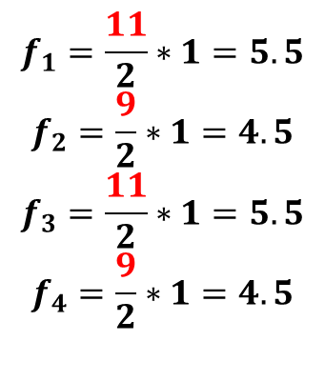
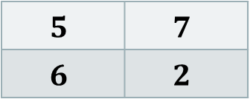
Multiplicative ART
ART: Algebraic Reconstruction Technique
Vertical
$$5$$ | $$7$$
$$6$$ | $$2$$
11
9
2
$$f_{1}=\frac{11}{2}∗1=5.5$$
$$f_{2}=\frac{9}{2}∗1=4.5$$
$$f_{3}=\frac{11}{2}∗1=5.5$$
$$f_{4}=\frac{9}{2}∗1=4.5$$
2
1 | 1
1 | 1
Notes:
初始=>1
分母=>標準
分子=>目前

Slide 25
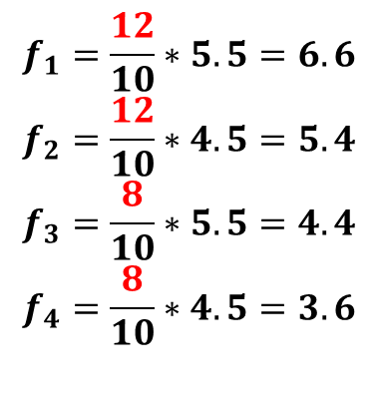
Multiplicative ART
ART: Algebraic Reconstruction Technique
Horizontal
$$5$$ | $$7$$
$$6$$ | $$2$$
$$f_{1}=\frac{12}{10}∗5.5=6.6$$
$$f_{2}=\frac{12}{10}∗4.5=5.4$$
$$f_{3}=\frac{8}{10}∗5.5=4.4$$
$$f_{4}=\frac{8}{10}∗4.5=3.6$$
5.5 | 4.5
5.5 | 4.5
10
12
10
8

Slide 26
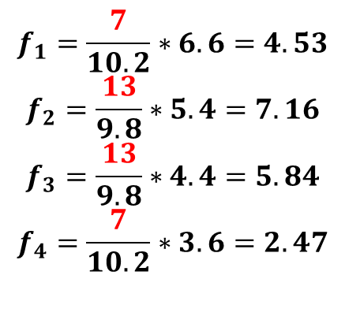
Multiplicative ART
ART: Algebraic Reconstruction Technique
Diagonal
$$5$$ | $$7$$
$$6$$ | $$2$$
7
13
10.2
9.8
$$f_{1}=\frac{7}{10.2}∗6.6=4.53$$
$$f_{2}=\frac{13}{9.8}∗5.4=7.16$$
$$f_{3}=\frac{13}{9.8}∗4.4=5.84$$
$$f_{4}=\frac{7}{10.2}∗3.6=2.47$$
6.6 | 5.4
4.4 | 3.6

Slide 27
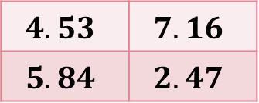
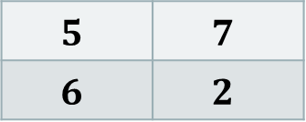
Multiplicative ART
ART: Algebraic Reconstruction Technique
Final
$$4.53$$ | $$7.16$$
$$5.84$$ | $$2.47$$
$$5$$ | $$7$$
$$6$$ | $$2$$

Slide 28
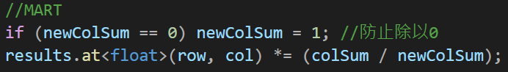
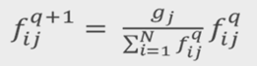
CODE
ART: Algebraic Reconstruction Technique

Slide 29
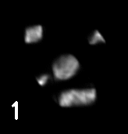
Multiplicative ART
ART: Algebraic Reconstruction Technique
16 Projections

Slide 30
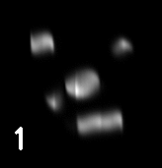
Multiplicative ART
ART: Algebraic Reconstruction Technique
180 Projections

Slide 31
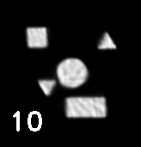
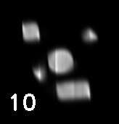
Multiplicative ART
ART: Algebraic Reconstruction Technique
16 Projections
180 Projections

Slide 32
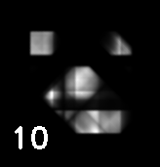



COMPARE Projections
ART: Algebraic Reconstruction Technique
4
10
16
30
60
180

Slide 33
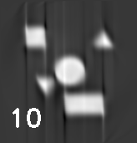
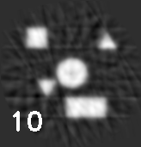
Additive vs Multiplicative
ART: Algebraic Reconstruction Technique
Multiplicative ART has better image quality.
Given less projections, Additive ART gives a more complete picture, so does Multiplicative ART.
Additive
180 Projections
10 Iterations
Multiplicative
180 Projections
10 Iterations
Additive
16 Projections
10 Iterations
Multiplicative
16 Projections
10 Iterations

Slide 34
Additive vs Multiplicative
More smooth
More clear
Can we combine the two feature?

Slide 35
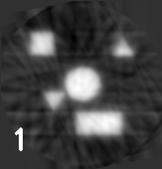
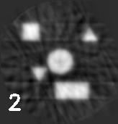
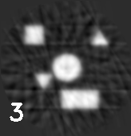





combine the two METHOD
Additive
Multiplicative

Slide 36








combine the two METHOD
Multiplicative
Additive

Slide 37







combine the two METHOD
Switch Method
Multiplicative
Additive

Slide 38
combine the two METHOD
What is the difference between the two methods
Additive | Multiplicative
Numbers can be negative | Numbers are always greater than or equal to 0
:

Slide 39

CODE
ART: Algebraic Reconstruction Technique

Slide 40








combine the two METHOD
Additive
(non-negative number)

Slide 41


COMBINE
Additive
(non-negative number)
Switch Method
+

Slide 42

ANOTHER graph

Slide 43






COMBINE
Additive
(non-negative number)
Additive
Multiplicative
Switch Method

